Slide 1
The Ph.D. in CS: Getting There and
Being Successful
Notes:
Version prepared fall 2019

Slide 2
What is a Ph.D. in CS and Why Should I Consider It?
Increase Knowledge
& Hone Research Skills
Advance the State-of-the-Art
Pursue Your
Interests
Study advanced topics, increase your CS knowledge & be trained to be a successful
researcher
Learn about and contribute to cutting edge CS research
Opportunity to pursue your own professional and intellectual interests in CS

Slide 3
More Great Reasons to Pursue a Ph.D
Gain Opportunities to Teach and Mentor
Pursuing a Ph.D. provides you with a unique opportunity to teach and mentor
Satisfy Your
Intellectual Curiosity
Get Paid to Learn!
Many students don’t realize that most C.S. Ph.D programs pay a comfortable stipend! Get paid to learn and increase your career earning potential!
Discover new things
Develop creative solutions
Identify new problems
Push the boundary of knowledge
Develop a habit of lifelong learning

Slide 4
The C.S. Doctorate (Ph.D) in a Nutshell
Timeline
Typically 5-6 years from Bachelor’s
Depending on school, starting with a Master’s degree may shorten timeline
Coursework
Typically “next level” CS foundations and (more) advanced electives
Research
Dissertation (aka Doctoral Thesis)
Oral/Written Exam along the way (e.g., qualifying exam)
Tuition & Stipend (Get paid to learn!)
Generally tuition is waived and you typically receive a stipend and health insurance from a teaching or research assistantship or fellowship
Career Paths
Academia (e.g., a professor)
Industrial, NPO, or government researcher or engineer
Entrepreneur (e.g., a start-up)
Higher-level development/leadership positions

Slide 5
Typical Timeline for Ph.D. Degree
Obtain preliminary results and publish papers. Formulate PhD research plan. Identify PhD committee. Begin writing proposal.
Foundational coursework to prepare for research.
Join a lab with advisor & initial project.
Continue to publish.
Write & defend dissertation. Prepare and interview for next job.
Year 1
Year 2
Year 3
Year 4
Years 5-6
Complete a majority of your coursework.
Take qualifying exam.
Identify research area. Potentially earn Master’s degree “along the way”.
Complete and defend PhD proposal. Continue with research and publishing your results. Identify your future career path.

Slide 6
How a Ph.D. differs from an M.S. Degree
Academic Master’s Program
3-4 courses/term in first year.
1-2 courses/term with a research and MS thesis or project in second year.
Typically not funded, but there is the potential serve as a teaching assistant.
Professional Master’s Program
Doctoral Program
Similar to Academic Master’s in the first 2 years. In years 3-5, primarily research. May serve as a teaching assistant, usually only for a few terms, then research assistant.
3-4 courses/term
for 1.5– 2 years.
Geared towards industrial careers.
Typically not funded by the school, but could be funded by a company you work for.

Slide 7
Presentation Roadmap
Preparing a Strong Application
Making a Smooth Transition
The First Few Years
The Research Apprenticeship
Preparing for After Graduation

Slide 8
Preparing a Strong Application for Ph.D. Admission
How to set yourself up for success, and make yourself an attractive applicant

Slide 9
General Preparation During Your Undergrad Years
Choose Courses Carefully
Seek Support to
Excel in Class
Get Involved in Research
Know Your Professors
Take challenging courses (maybe even grad classes) and get broad foundations.
Performance in advanced courses is important. Set your self up for success by working hard and seeking support when you need it.
Undergraduate research is typically expected by admissions committees. Find a faculty member and ask to work with them.
Get to know your professors. Talk to them about your plans and interests. Build a relationship!

Slide 10
What Graduate Schools are Looking For…
Prior Research Experience,
Publications
Potential for Becoming a Leader in the Field
Evidence of being
Creative, Hardworking, & Persistent
Your Academic
Choices and Performance

Slide 11
The Four Major Application Components
Personal
Statement(s)
Undergraduate
Transcripts
Letters of Recommendation
GRE
Test Scores
(for now)

Slide 12
Writing an Effective Personal Statement
Describe your prior research experience
Describe your future research interests
Demonstrate that you have ideas for interesting and important problems to study
Make it personal or unique to you!
Personalize your statement with at least one paragraph about why the department interests you
Have at least one faculty member give you feedback
More guidelines:
Statement of Purpose Guidelines (MIT)
Writing the Statement of Purpose (UC Berkeley)
Statement of Purpose for Graduate School (Princeton Review)

Slide 13
Getting Strong Letters of Recommendation
3-4 Letters Typically Required
Make Each Letter Count
Letters from Other Disciplines
Internship
Supervisors
Have at least one letter from a faculty member with whom you did research. No letters from advisors or Tas. Limit letters from lower-level instructors.
A letter that only says “this student did well in my class” is not very helpful.
Sometimes it can be hard to find 3-4 CS professors who know you well. It’s okay to have letters from faculty in other related technical fields ( e.g., EE, Math, etc.)
A letter from a supervisor during a summer internship is fine. However, the internship supervisor should have a PhD, and it is preferable if the internship is research focused

Slide 14
Getting Strong Letters of Recommendation
For example…
“I’m applying to graduate school. Would you feel comfortable writing a positive letter for me? If so, I’d be grateful. If you are not able to do this for any reason, I’ll certainly understand.”
Give Them a
Way to Say “No”
Helps to Have Built a Relationship
Provide a resume and a transcript when asking. Ask which other materials they would like to see (e.g., a statement of purpose).
Neutral letters will not have much impact. Make sure such writers can decline your request
Additional tips for requesting letters: https://gradschool.cornell.edu/diversity-inclusion/recruitment/prospective-students/requesting-letters-of-recommendation/

Slide 15
GRE Exam & Scores
Check if GRE Scores are required by the institutions that you are applying to
Investigate the expected GRE score ranges, and the scores importance to the application
Prepare for the exam! Taking practice tests can help immensely
You can retake the exam if you feel you could do better. However, the previous scores will still appear on your application
Resources:
https://www.princetonreview.com/grad/gre-information
http://www.ets.org/gre

Slide 16
What if I Don’t Have a CS Undergrad Degree?
You can still apply, but demonstrate your technical knowledge, ability to do graduate level research and equivalent coursework
Consider obtaining a research-focused MS degree first
You may be able to take foundational courses in the first year to build background.
The requirements depend on the school.
Make sure to check the admissions requirements for the schools you apply to

Slide 17
Working Before Grad School: Pros & Cons
Advantages
Work can give a clearer picture of your interests, and research interests.
Work can teach discipline and time management
Graduate schools tend to value work experience; can make up for less-than-stellar grades
Some employers will pay or provide time off for a professional Master’s
Disadvantages
It can be difficult to go back to school with family and/or financial responsibilities
Giving up a good salary can be tough
Balancing part-time graduate school with a full time job can be challenging
Getting recommendation letters from previous faculty can be tough

Slide 18
What About Pursuing a Ph.D. Part-time?
Earning a Ph.D. part-time is uncommon
This can be difficult as the research component of the PhD often requires full-time attention
This is somewhat common for Master’s degrees
Some employers will cover tuition costs if you continue to work full time
Typically, a full-time Master’s will take about 2 years (part-time often 4 years).

Slide 19
The Admissions Process
How to decide where to apply and choose among your acceptances

Slide 20
Typical Admissions Timeline
Ask letter writers
Give them Resume, Personal Statements & transcripts
Finalize application materials and get feedback
Submit applications
Take challenging CS courses
Prepare for and take the GRE
Continue doing research
Summer after Junior Year
Fall Senior Year
Spring Senior Year
Junior Year
Hear back from Schools
Go on Campus visits
Make a decision!
Decide which schools to apply to
Narrow down list of professors for recommendation letters
Update your Resume
Conduct Summer Research
Draft Personal Statements

Slide 21
Five Factors to Consider When Applying
1) Strong Research Groups/advisors in your area
2) Healthy Student and Academic Culture
3) Financial Support Offered by the Program
4) Department Rankings
5) Location preferences

Slide 22
How many Applications to Submit?
Minimum:
2 ”Safe Schools”, 3 “Good Matches”, 3 “Slight Stretches”
Most students are advised to apply to 8-12 schools, selected in communication with their advisor.
The “top few” schools should be considered stretches in almost every case.
Talk to your Advisor and other faculty in your research areas of interest with whom you feel comfortable.

Slide 23
What are Typical Acceptance Rates?
Only estimates on ranges exist
Type of School | Acceptance Rate
Top 4 | 5-10%
Top 5-10 | 15-20%
Top 11-25 | 30-45%
International Students
Domestic
Students
Keep in Mind
Ranges are based upon individuals with admissions experience
Applicant pool is more self-selected than for undergrad admissions.
Acceptance rates tend to be lower for international students
Acceptance rates for professional master’s programs are much higher

Slide 24
Acceptances and Campus Visits
(Winter/early Spring semester)
Go on Campus Visits!
Many schools invite accepted applicants for a campus visit.
Make use of it (often free) and meet people and see the department!
If/when you get too many visit invitations, prioritize based on your factors, ask your advisor for guidance
Campus Visit Checklist
Book your accommodations through the university (if possible)
Set up meetings with faculty and staff. Meet with grad office staff.
Ask to meet with Ph.D. students
If you have special needs, meet with the appropriate campus office
Inform yourself about the department.

Slide 25
On Choosing the Right Ph.D. Program for You
Questions to Ask:
Are there a number of faculty in your desired research area?
Are they taking on students?
How does funding work in the department? Are you supported the first year? Does the support come from faculty or the department?
What is the atmosphere like in the Department/Lab? Collaborative? Competitive?
Do you have to work with advisors who currently already have funding?
How frequently do students meet with their advisor?
Are their advisors helpful?
How many years of funding are guaranteed with good progress? Does the school have accessible resources (library, counseling, etc.)?
Were students in the department excited about their research?
What is the cost of living in the area where the school is located?
Notes:
DG: I criticized an earlier slide on what-to-consider, so I'll say I like this slide. :)
JP: I like this slide too and don't know whether it belongs earlier something minor to add could be: ease of accessibility of resources like mental health, library support, etc. what is the network like?
DP: Think this slide belongs here, because these are things that can largely only be determined by a visit (or maybe talking to someone who is there). I added a brief point about school resources from Joslenne.

Slide 26
Knowing your Research Interests vs. Being Unsure
Knowing Your Area
Top programs will expect you to have an area of research interest before enrolling.
However, other schools may offer more flexibility in choosing a research area.
Knowing the area you would like to work in (and having research experience in that area) can, however, make a big difference
Contacting Potential
Advisors
Usually, professors do not respond to e-mails until students are admitted.
More likely to get responses from a smaller departments receiving fewer applications.

Slide 27
Financial Support Options
Teaching Assistantship
Requires 20 hours of work per week to help the course instructor develop and offer in course. Typical duties include grading and running lab/discussion sections.
Research Assistantship
Fellowships
RAs typically require working with your research advisor on a funded project. Having an RA typically requires that your advisor has research funding.
NSF Graduate Fellowship, DOE, DOD, DHS, industry and foundation fellowships as well as university designated fellowships.
May be viewed as more prestigious and offer more research freedom.

Slide 28
Applying for Fellowships
NSF GRF
Hertz Foundation
Early November Deadline
Late October Deadline
Ask advice on what is best for your career stage.
Get example applications.
Get feedback on your application.
NDSEG
Homeland Security Fellowships
Early January Deadline
Early January Deadline

Slide 29
Making a Smooth Transition into Grad School
How to prepare for a successful start to your graduate studies

Slide 30
Before Classes Start: Settling in & Learning the Ropes
Know Your Program Requirements
What are the hurdles associated with completing a Ph.D. degree?
What are the course requirements?
What exams will you need to pass and when?
Are the teaching requirements?
By when do you need to find an advisor?
How many years do you have to to complete your degree?
Helpful Tips
Get to know your peers and near peers
Create study groups
Establish hobbies and friends outside the department
Find mentors
Get to know your school environment and resources
Create a comfortable studying and living environment for yourself

Slide 31
A Typical Semester in a C.S. Ph.D. Program
Structure of Coursework
Undergrad is CS + breadth courses; Usually 4-5 courses/semester.
B.S. and M.S. degrees are about taking courses: 3-4 courses/semester. Mostly or all are CS courses.
While you still take <10 courses during the Ph.D. in the first 3-4 semesters, the emphasis is on research!
Key Differences between
Classes & Research
Class assignments have known answers; research problems may not even have a solution
In classes, you are assigned problems; in research, you get to pick ones to work on
In classes, you can ask for help. In research, help may not be available (in some cases even your advisor may not have immediate response)
In research, you work side by side with other research students, post-docs, and your advisor

Slide 32
The First Few Years
Taking courses and getting involved in research

Slide 33
Taking Courses
Ph.D. typically requires <10 courses
Remember, focus during the Ph.D. is on research!
Choose classes related to the potential research area
Ask your adviser for advice and recommendations. They may have expectations.
If you are interested in working with a particular faculty, take their course. Do very well. Possibly consider a course project as research.
Consider taking courses outside CS relevant to your research (e.g., Stat, Math, Psychology, Computational Linguistics)

Slide 34
Getting Involved in Research Early
Getting involved in research early is the most important thing to do for overall success!
The research process (finding an advisor, a research problem, obtaining initial results, getting these results published) takes time, so the sooner you start the better!
“Keep in mind that no one can give you a complete picture of what research is. The best way to learn what research is, and whether you like it, is simply to start doing it. The earlier the better!”
https://www.cs.cmu.edu/~harchol/gradschooltalk.pdf

Slide 35
Finding a Healthy Work/Life Balance
Graduate school does not have to be 9-5
Find the most productive hours for you and schedule ~8 working hours at that time
Make working time productive!
Research is much more about the quality of the output rather than the hours spent
Set clear goals, get feedback and reward yourself
Talk regularly to your advisor; make sure goals and expectations are aligned
Schedule personal time!
It is easy to keep working; however, time off is important
Banish the Guilt!
Take breaks to be able to produce your best work.
Tap your support network!

Slide 36
The Research Apprenticeship
Finding an advisor that fits you and conducting impactful research

Slide 37
How to Find an Advisor
Choice of an advisor is one of the most important decisions to make in graduate school
Renowned vs. beginning researchers
Do your homework! Check the following information for a potential advisor’s Ph.D. students:
How many students and when they graduated?
How many papers (and where) students published with their advisor?
Where are those students now (academia, industry)?
Talk to faculty during office hours, attend their talks
Ask to attend research meetings of a group you are interested in joining
What is the advisors collaboration style like? 1:1 Meetings?

Slide 38
What are Advisors Looking for?
It’s important to understand what Advisors are looking for:
a trial period before committing an RA position
excellent performance in their class
specific technical or research skills (e.g., systems building, ability to come up with proofs etc)
writing skills
critical thinking skills
More advice/resources on finding an advisor:
Tao Xie’s Guide: http://taoxie.cs.illinois.edu/advice/gradstudentsurvival.pdf
Philip Guo’s Ph.D. Grind: http://www.pgbovine.net/PhD-memoir.htm

Slide 39
Tips for Conducting a Successful Research Project
1) Identify an important problem you are passionate about
2) Devise a new solution or study – approach the problem from a new viewpoint
3) Create a plan for the work, and stick to it! – Expect setbacks, and work through them
4) Rigorously evaluate your solution or explain your findings

Slide 40
What do Ph.D. Students do in the Summer
Internship with an industrial or government research lab
Work on research full time
Attend conferences or summer schools
Teach a course at your home institution to gain experience

Slide 41
Preparing for Graduation & Beyond
Preparing for your chosen career path

Slide 42
Making the most of your Final Years in the Ph.D.
Interested in a Faculty Position?
Sign up to teach a class
Offer your advisor to help with a grant proposal writing
Above all, use your time at conferences and your grad school contacts effectively to network with peer researchers and develop possible future collaborations
Interested in an Industry Position?
Interested in a Teaching Faculty Position?
Take at least one internship
Often, students interested in industry will take multiple internships
Sign up to teach multiple classes, develop curricula, collect student feedback

Slide 43
Becoming a (Tenure-Track) Professor at a University
Do research on anything you like!
Working with graduate and undergraduate students
Teaching classes
Applying for grants
Attending conferences and giving talks
Doing service for your department, university and research community
If you are interested in becoming a Research Professor than you do pretty much everything listed above but the teaching

Slide 44
Becoming a Teaching-Focused Professor at a Research University
Workload is focused primarily on teaching and curriculum development
Occasionally advising MS and/or undergraduate students
Doing service for the Department, University and CS education community
Potentially conduct some CS education research based on your interests and curriculum development and course activities
Typically, promotion in academic rank, but no tenure (multi-year contracts). Positions vary across universities

Slide 45
Becoming a Professor at a Teaching University
Primarily teaching classes
Occasionally advising MS and/or undergraduate students
Occasionally attending conferences and giving talks
Doing service for your Department, University and Research community

Slide 46
Becoming a Scientist at a Research Lab
Doing research
typically a mix of what you want and what your company needs
Working with other people in the company
Occasionally attending conferences and giving talks
Doing service for your Research community
Serving on program committees reviewing papers
Participating in organizing conferences
Serving on advisory boards for universities etc.

Slide 47
In Summary: Why should you pursue a Ph.D. in C.S.?
Increase Knowledge
& Hone Research Skills
Advance the State-of-the-Art
Pursue Your
Interests
Study advanced topics, increase your CS knowledge & be trained to be a successful
researcher
Learn about and contribute to cutting edge CS research
Opportunity to pursue your own professional and intellectual interests in CS

Slide 48
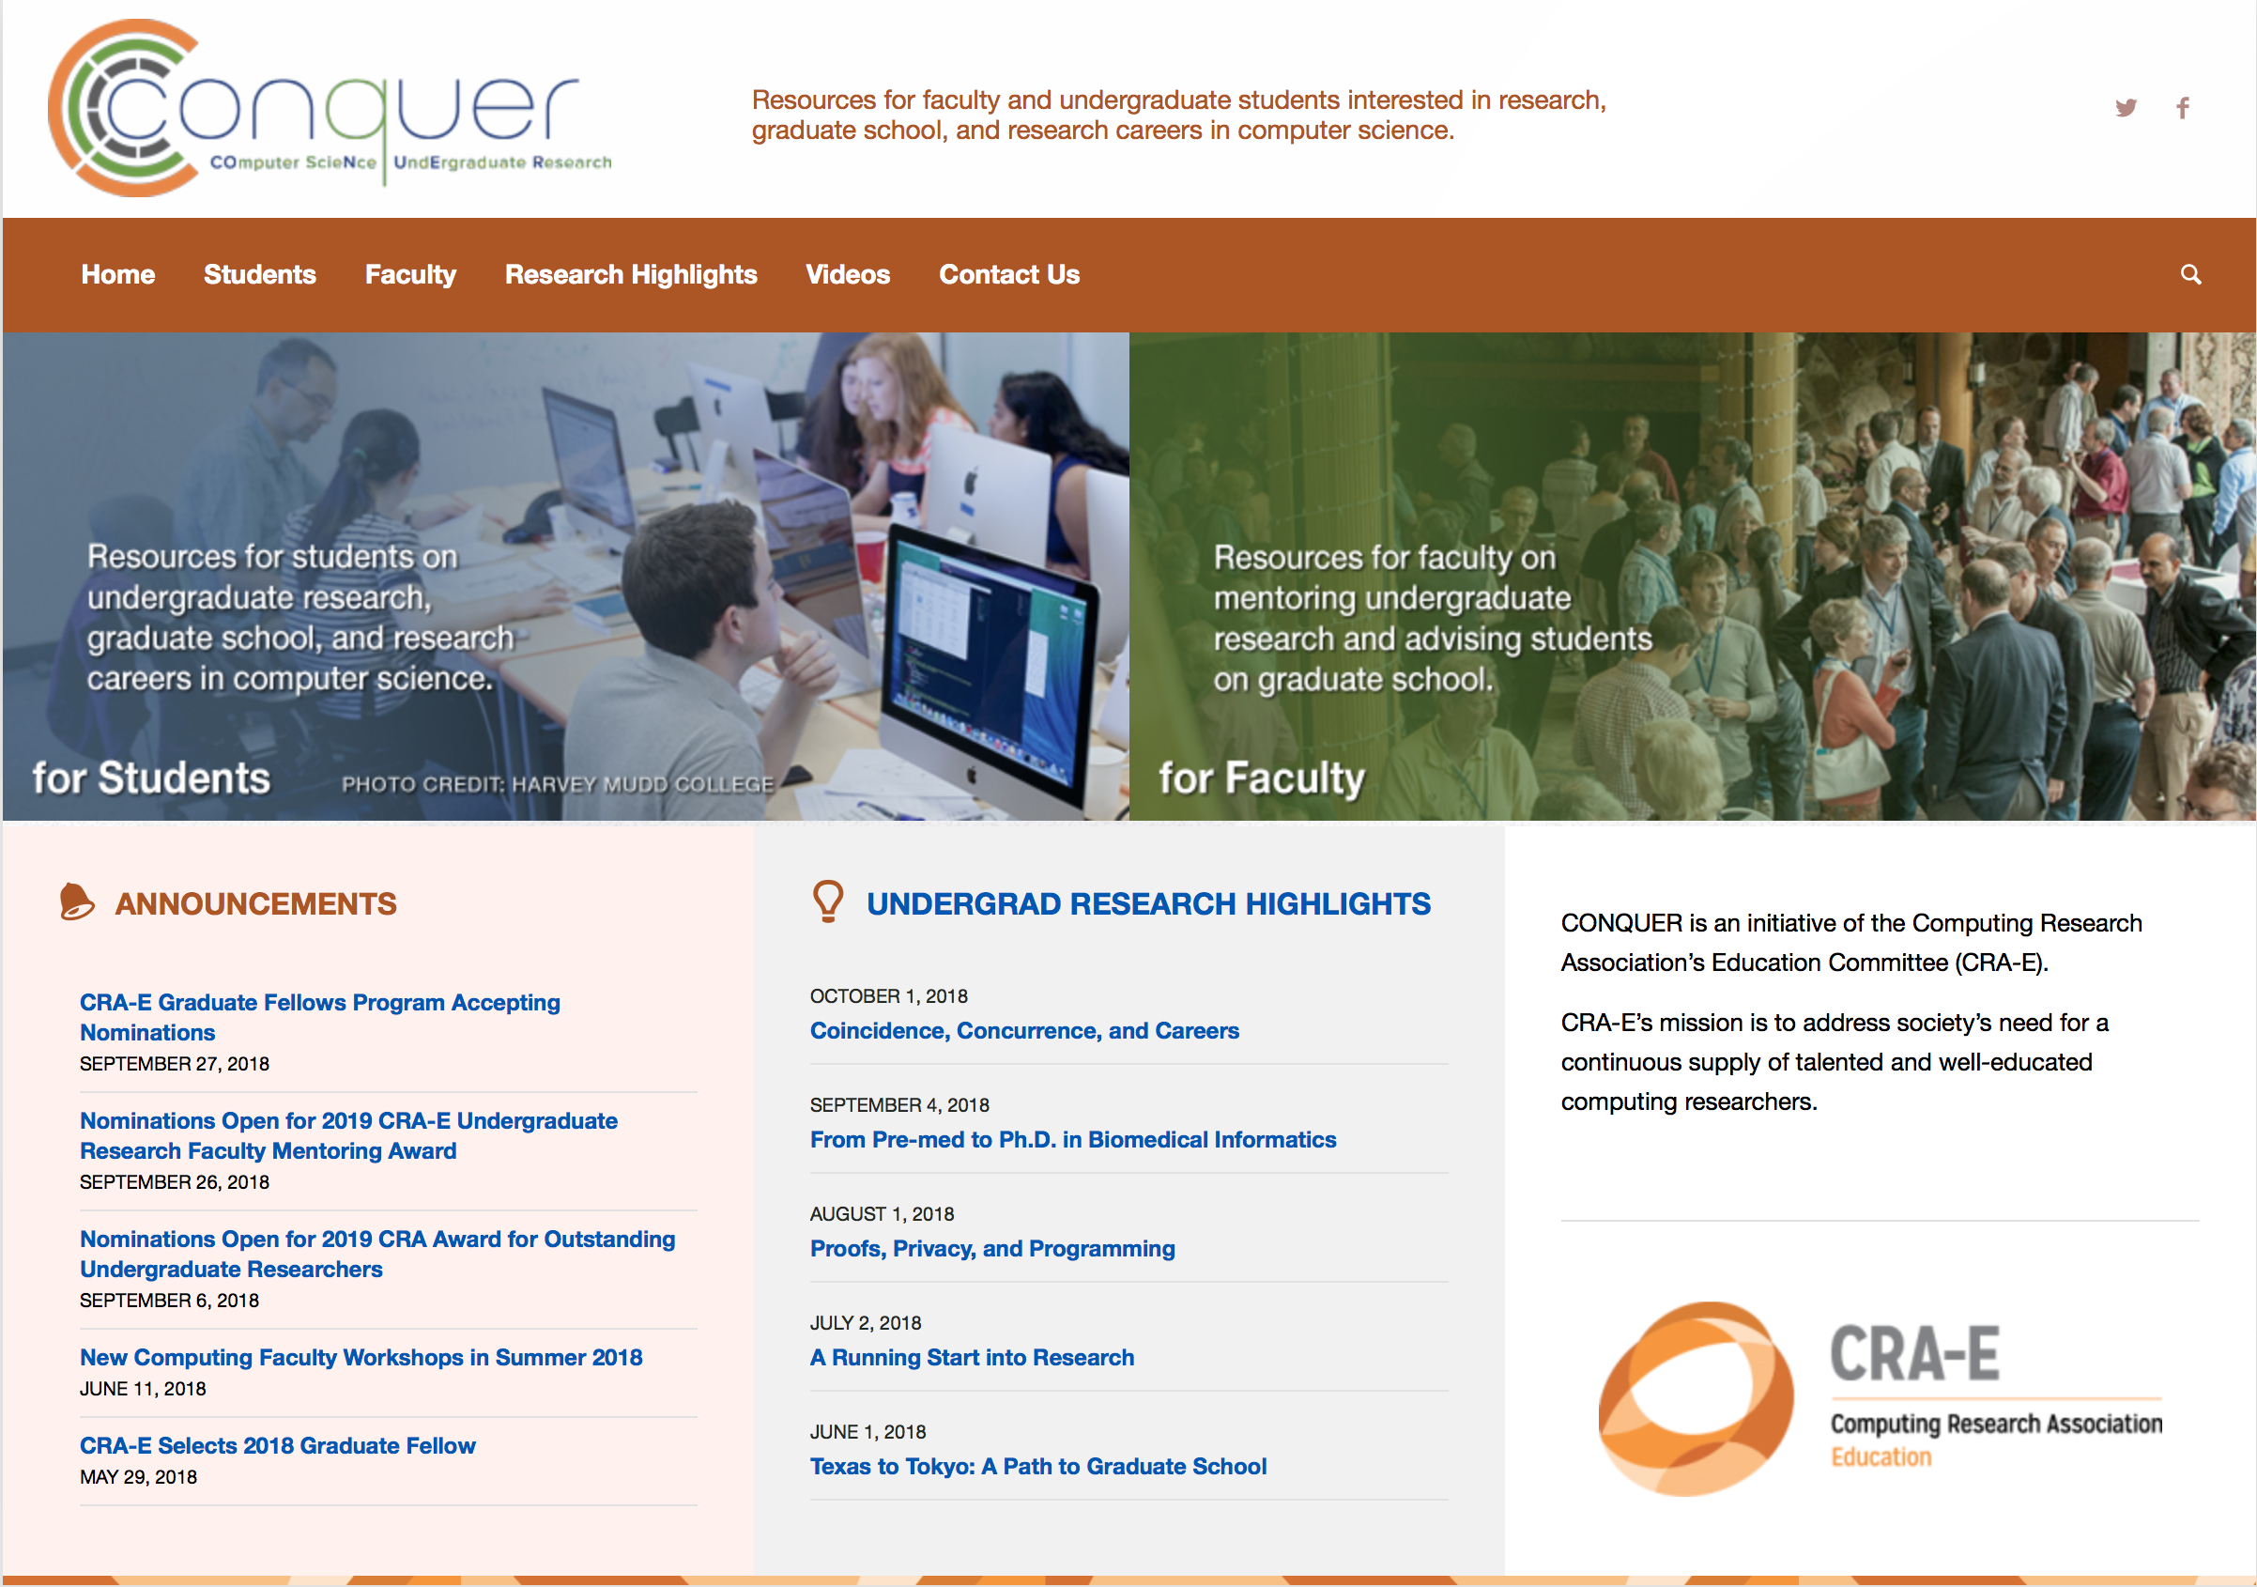
Want More Info? Check Out Conquer!
A website specifically for undergraduate research and graduate school advice in CS
http://www.conquer.cra.org

Slide 49
CRA-E’s mission is to address society’s need for a continuous supply of talented and well-educated computing researchers.
http://www.cra.org/crae

